Slide 1
Module P6
Practical: Introduction to APIs

Slide 2
Contents
Objective:
Learn how web APIs work
Learn how clients make requests to web APIs
Learn what JSON is
Topics:
Update our profile page
Add a counter endpoint
Update the profile page to contain a counter button
Add an API endpoint that accepts data and sends data

Slide 3
Code demo (HTML + CSS)
Let’s update our profile page:
Add a new image
Add 2 sections
Add a footer area

Slide 4
Counter endpoint
If a particular URL is requested:
It should increment a counter
Return the value of that counter
Eg: First time I go to /counter response is 1. Next time I go to /counter the response is 2.

Slide 5
Code demo (server-side JS)
Let’s write this simple counter URL

Slide 6
Counter on the home page
Let’s add a button to the home page.
Every time the button is clicked we show the increased counter value

Slide 7
Code demo (HTML + client-side JS + AJAX!)
Let’s write this simple counter URL

Slide 8
Review of making data calls
Without refreshing the page, from within the page, we made a request for a new piece of data.
We got the data and displayed it by converting that data into an HTML string (like what the server does) and inserting that into the existing HTML document.
This business of making calls to the web server without refreshing the page is called making AJAX calls.
Some webapps never need the page to be refreshed, like gmail. These are called Single Page Apps.

Slide 9
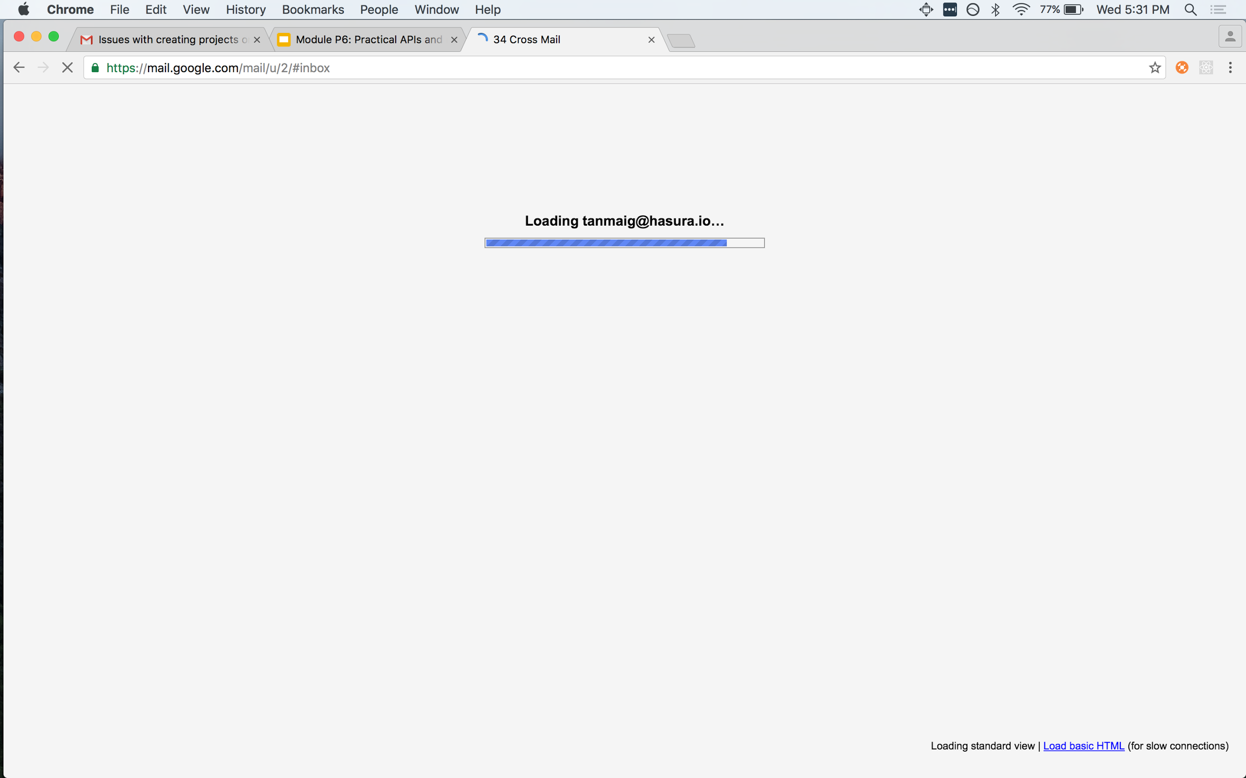
Client side templating
This is how gmail works!
Check it out on inspect element.
When you load mail.google.com only the HTML and JS files are fetched. These don’t contain any email data
Then the JS on the browser makes a request to fetch emails
These emails are then converted to HTML and inserted dyanmically on to the existing page
This is known as client side rendering!

Slide 10
How can I do more complex stuff though?
In our current example, we were just making a request to a URL endpoint
But suppose we want to send data to the server?
Suppose the response from the server is more complex data and not just a string (text) that represents a number
Eg:
Send a simple string as a parameter (gmail responds with a list of emails when you give it a search string as a parameter)
Send a limit and an offset (for example when you keep scrolling on e-commerce sites and products keep appearing)
Receive an object as a response (gmail responds with a list of emails that are your inbox)

Slide 11
Our task
Create an input box
On click on a button, name will be sent to the server
Server will respond with a list of all the emails
All the emails will be shown on the page as a bulleted list

Slide 12
Code demo (HTML, CSS, client-side JS)
Create an input box
Create a bulleted list of elements

Slide 13
Code demo (server-side JS)
An endpoint that takes a name as an input and returns an output which is a list of names submitted so far
/submit-name
Input: “tanmai”
Output: “tanmai”, “ramu”, “shyamu” etc.

Slide 14
Key takeaways
An API endpoint is technically the same thing as a normal URL endpoint
API endpoint is typically used to send just data back to the client
So /counter is an API endpoint but /article-one is not
API endpoints can return data in any format
Popular standard to receive and send data for APIs is JSON which is a string representation of a Javascript object

Slide 15
Student task!
Add a comments box on every page
Add an input box at the bottom of every article page
Once a comment is submitted, all the comments ever submitted are returned by the server and displayed on the article page

Slide 16
Tip Of The Iceberg
In this entire course, we will not be learning a specific programming language or a framework
This course is about learning the right fundamentals and enough specifics to build a basic app
Over the next 2 weeks, we’ll be getting back to more theory about databases, performance, authentication and concurrency
Use that time to build your ultimate profile and blog pages
Add styling (use CSS)
Add comments (use AJAX calls and render comments)
Add a list of all articles on the home page that link directly to the article page
Useful things to learn if you are going to go into web development
Bootstrap (for CSS)
JQuery (for client side Javascript)

